Slide 1
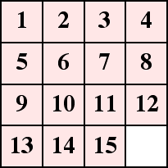
Sliding Block Puzzle Solver

Slide 2
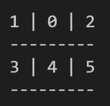
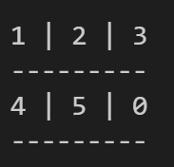
The Problem
What are the least number of moves?
What are the steps to achieve solution in least number of moves?

Slide 3
The Solution
Step 1
Step 2
Step 3
Visiting all the reachable states from a given state
Exiting the search as soon as solution state is reached and generating the path.
Breadth First Search with initial state of grid as root state

Slide 4
Architecture
Matrix State represented in form of string.
Used a singly linked list of string to check if a state is already visited or not.
Used a queue-cum-tree which will work as a simple queue as well as stores the parent node of a node pushed to the queue to generate the path back to root node.
Reversed parent list of the solution node at the end to generate path from root node.

Slide 5
Let’s move on to execution

